Slide 1
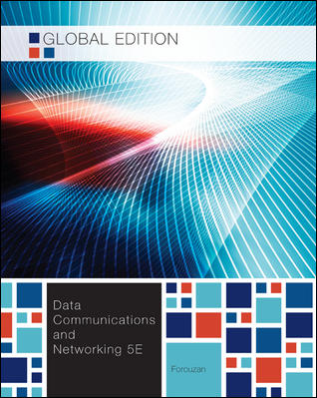
Chapter 5
Analog
Transmission
School of Computer Science and Engineering
Pusan National University
Jeong Goo Kim

Slide 2
Ch. 5 Outline
    Outline
5.1 Digital-to-Analog Conversion
5.2 Analog-to-Analog Conversion

Slide 3
    Ch. 5 Objective
    Objective
Digital-to-Analog conversion (digital modulation)
  ASK
  FSK
  PSK
  QAM
Analog-to-Analog conversion (Analog modualation)
  AM
  FM
  PM

Slide 4
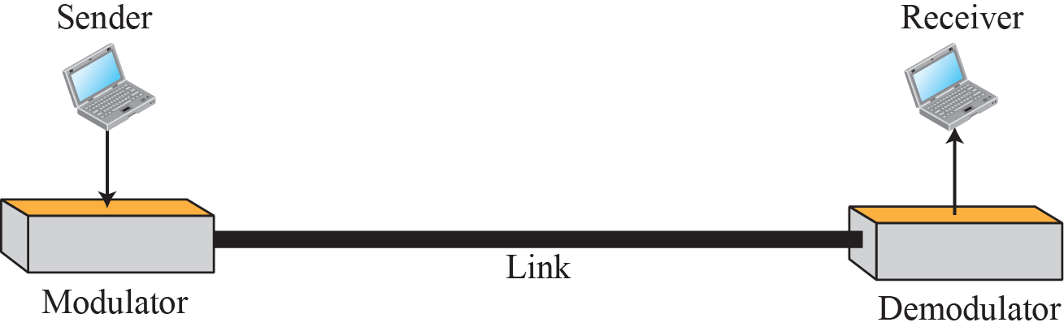
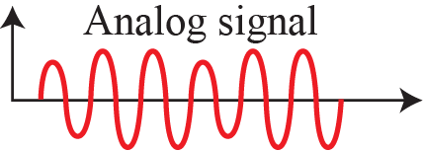
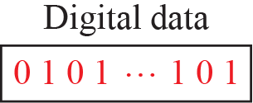
    5.1 Digital-to-Analog Conversion
    5.1 Digital-to-Analog Conversion
is the process of changing one of the characteristics of an analog signal based on the information in digital data
Fig. 5.1 Digital-to-analog conversion

Slide 5
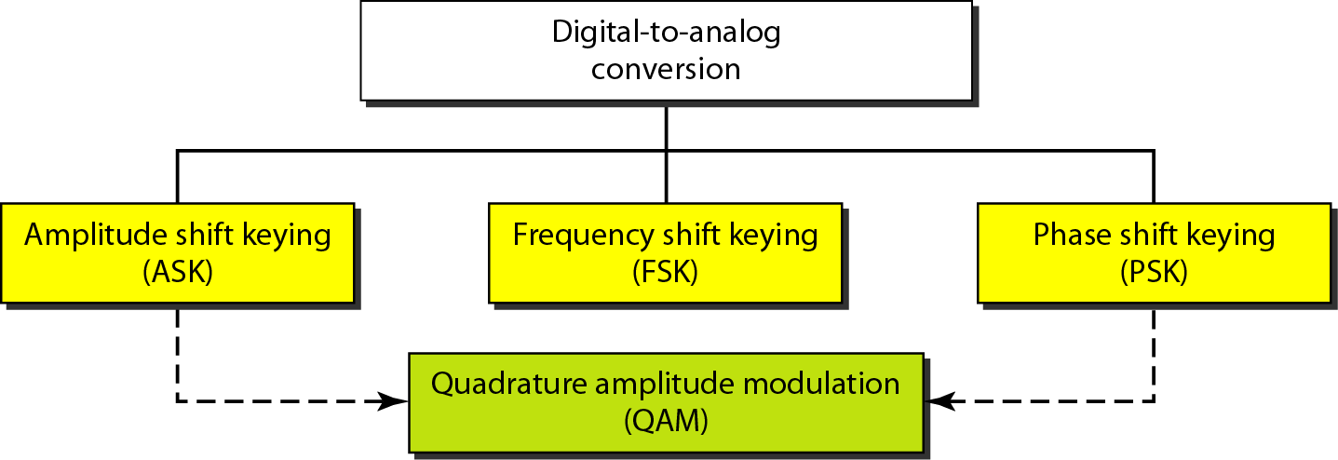
    5.1 Digital-to-Analog Conversion
Fig. 5.2 Types of digital to analog conversion

Slide 6
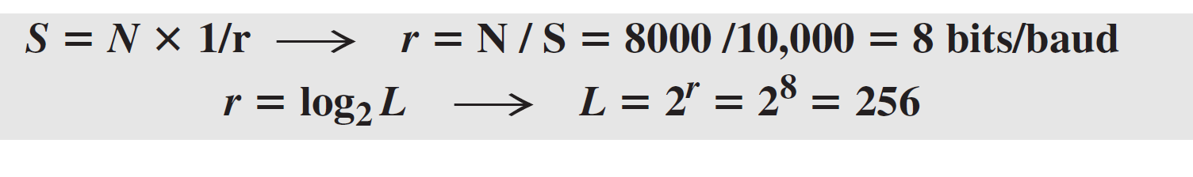
    5.1 Digital-to-Analog Conversion
    5.1.1 Aspects of Digital-to-Analog Conversion
    Data Element vs. Signal Element
    Data rate vs. Signal rate
    Ex. 5.1
    Ex. 5.2
    Bandwidth
    Carrier Signal

Slide 7
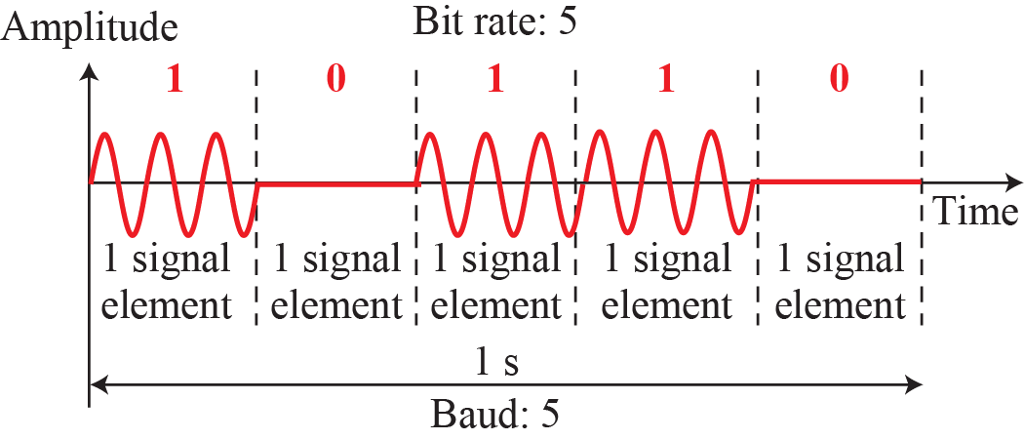
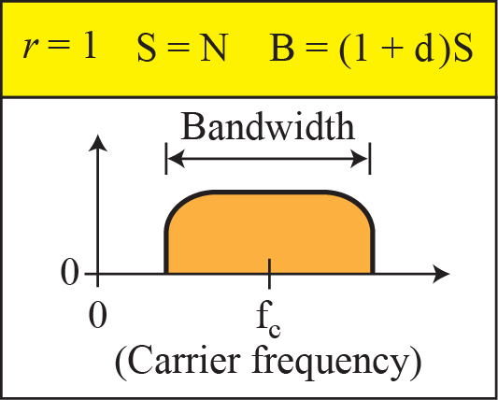
    5.1 Digital-to-Analog Conversion
    5.1.2 Amplitude Shift Keying (ASK)
the amplitude of the carrier signal is varied to create signal elements.
Binary ASK (BASK)
Fig. 5.3 BASK

Slide 8
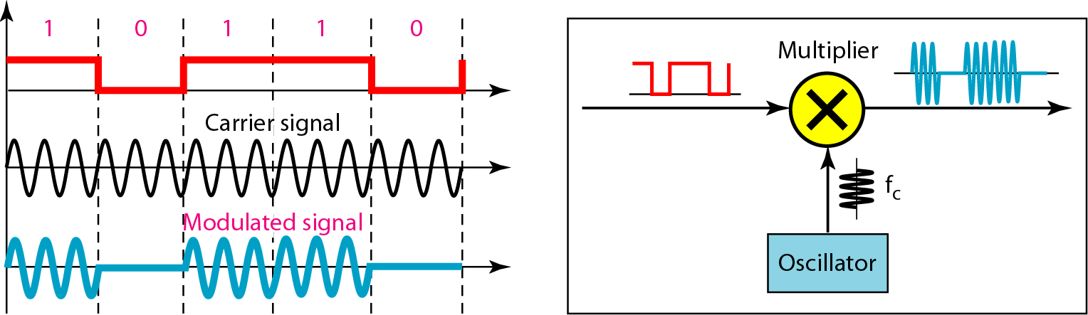
    5.1 Digital-to-Analog Conversion
Bandwidth for ASK
B = (1+d) × S, 0 ≤ d ≤ 1, S: signal rate
Implementation
Fig. 5.4 Implementation of BASK

Slide 9
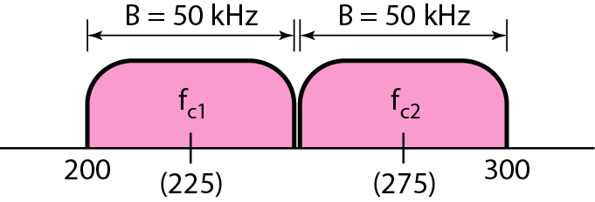
    5.1 Digital-to-Analog Conversion
Ex. 5.3
Ex. 5.4
Fig. 5.5 Bandwidth of a full-duplex ASK in Example 5.4
Multilevel ASK

Slide 10
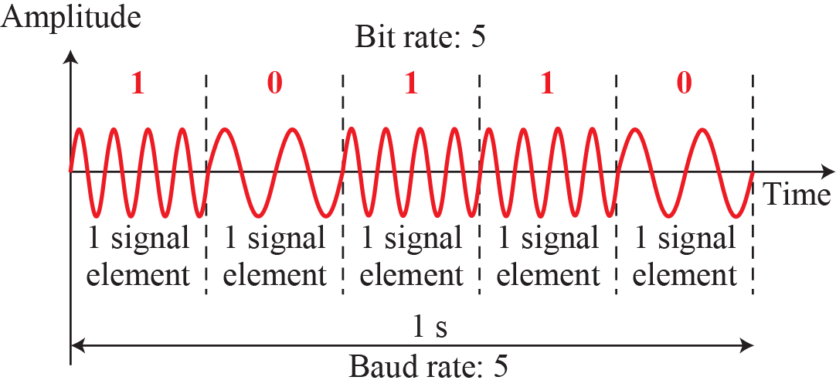
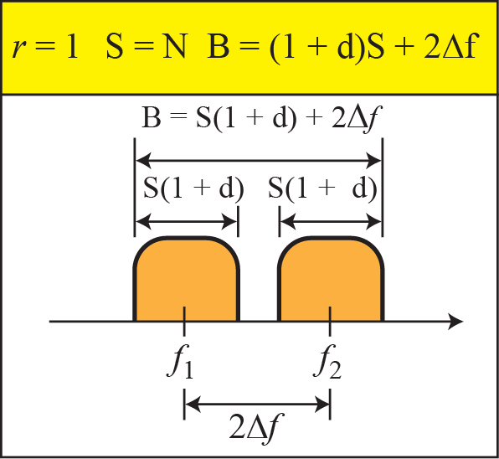
    5.1 Digital-to-Analog Conversion
    5.1.3 Frequency Shift Keying (FSK)
the frequency of the carrier signal is varied to represent data.
Binary FSK (BFSK)
Fig. 5.6 BFSK

Slide 11
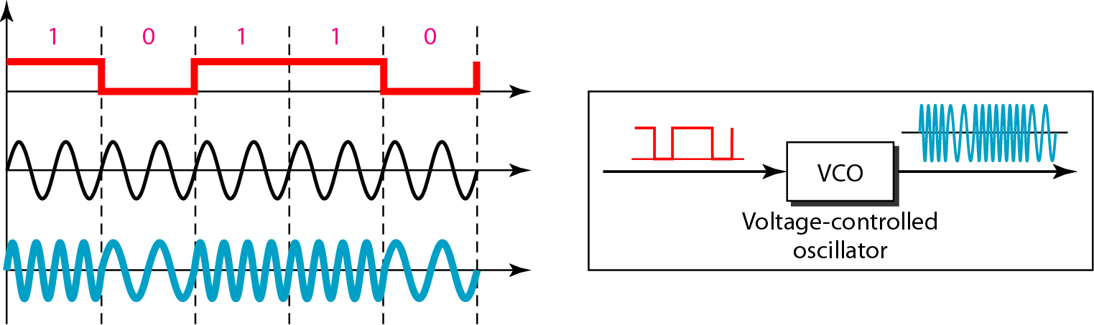
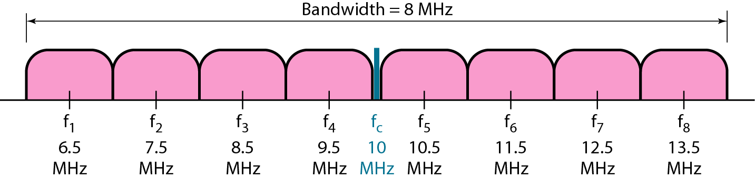
    5.1 Digital-to-Analog Conversion
Fig. 5.7 Implementation of BFSK
Multilevel FSK
Fig. 5.8 Bandwidth of MFSK used in Example 5.6

Slide 12
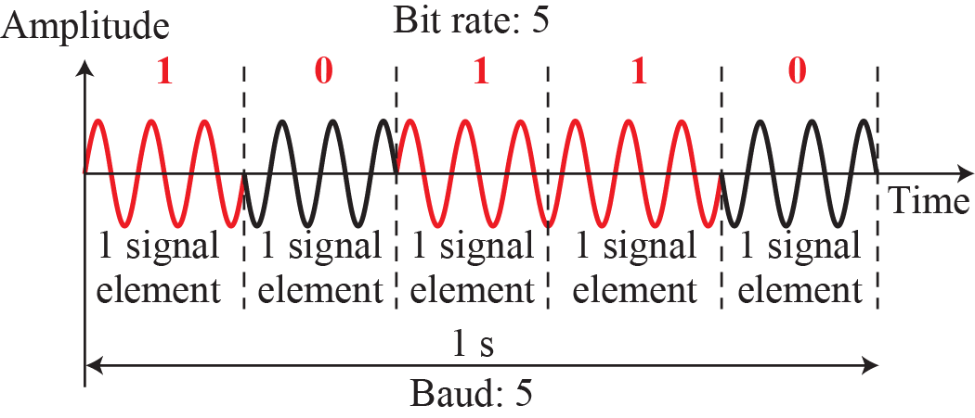
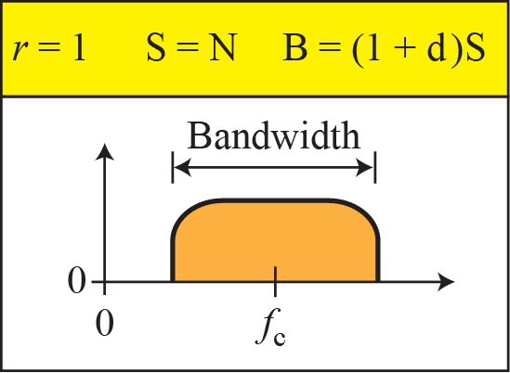
    5.1 Digital-to-Analog Conversion
    5.1.4 Phase Shift Keying (PSK)
the phase of the carrier is varied to represent two or more different signal elements.
Binary PSK (BPSK)
Fig. 5.9 BPSK

Slide 13
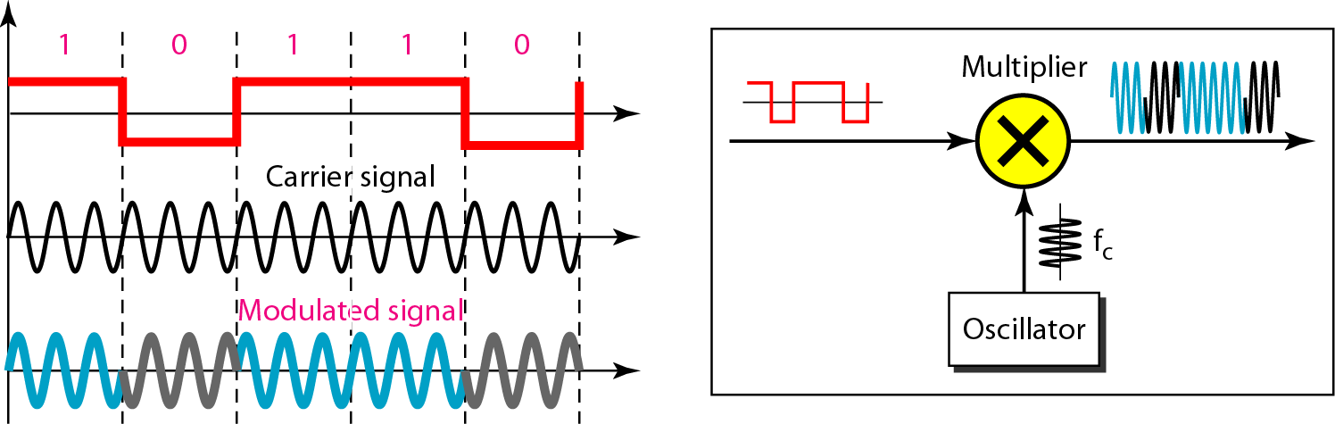
    5.1 Digital-to-Analog Conversion
Fig. 5.10 Implementation of BASK

Slide 14
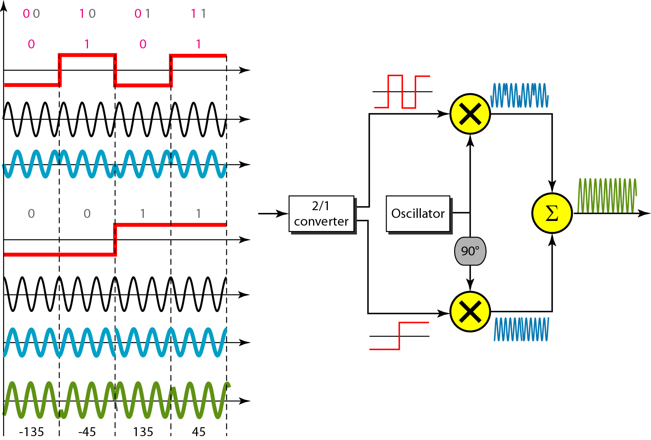
    5.1 Digital-to-Analog Conversion
Fig. 5.11 QPSK and its implementation

Slide 15
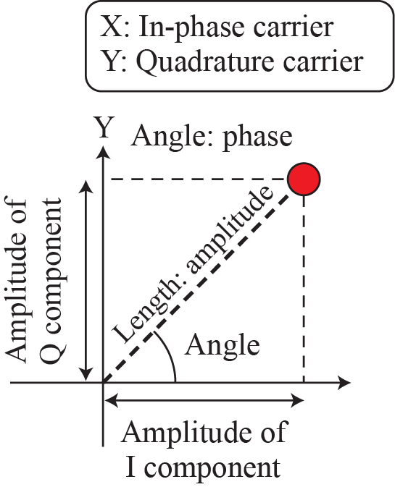
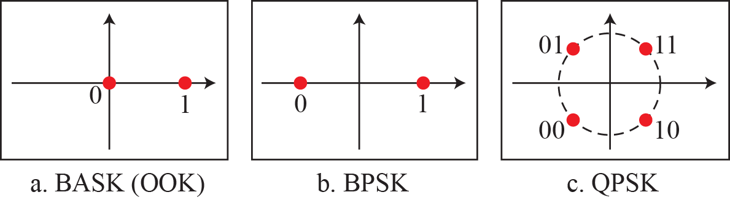
    5.1 Digital-to-Analog Conversion
Fig. 5.12 Concept of a constellation diagram

Slide 16
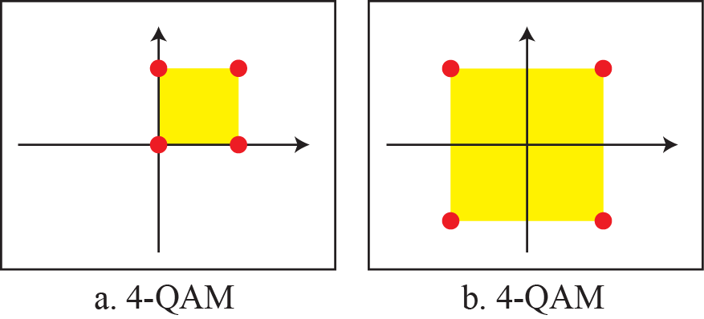
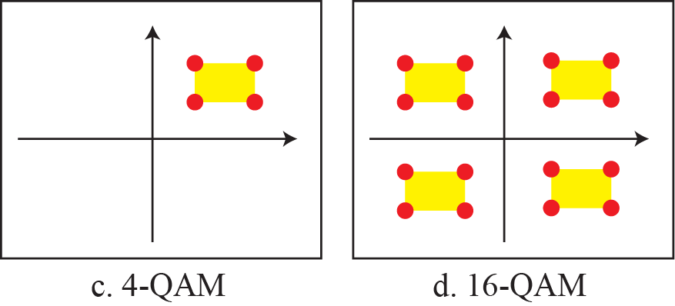
    5.1 Digital-to-Analog Conversion
    5.1.5 Quadrature Amplitude Modulation (QAM)
is a combination of ASK and PSK.
Fig. 5.14 Constellation diagrams for some QAMs

Slide 17
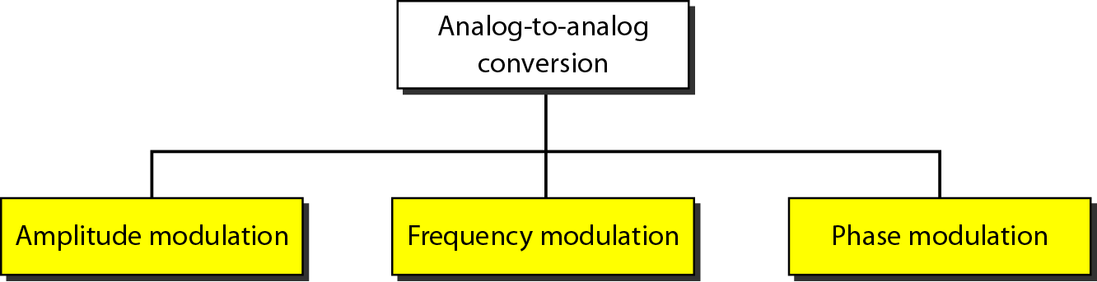
    5.2 Analog-to-Analog Conversion
    5.2 Analog-to-Analog Conversion
is the representation of analog information by an analog signal data.
is needed if the medium is bandpass in nature or if only a bandpass channel is available to us.
Fig. 5.15 Types of analog-to-analog modulation

Slide 18
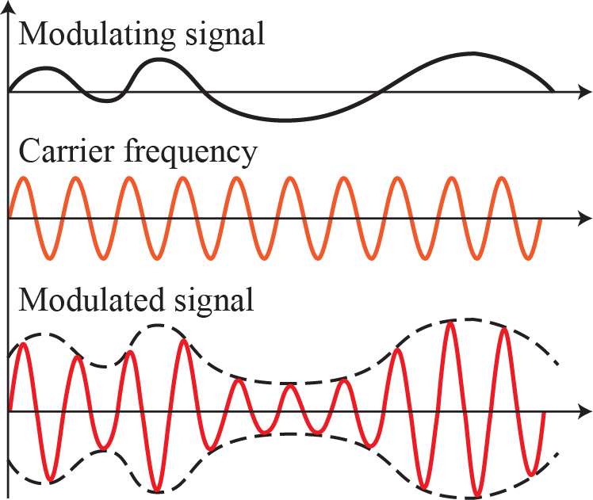
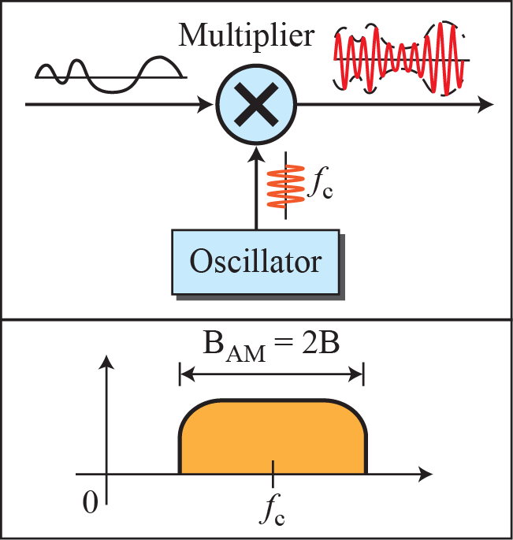
    5.2 Analog-to-Analog Conversion
    5.2.1 Amplitude Modulation (AM)
its amplitude varies with the changing amplitudes of the modulating signal.
Fig. 5.16 AM

Slide 19
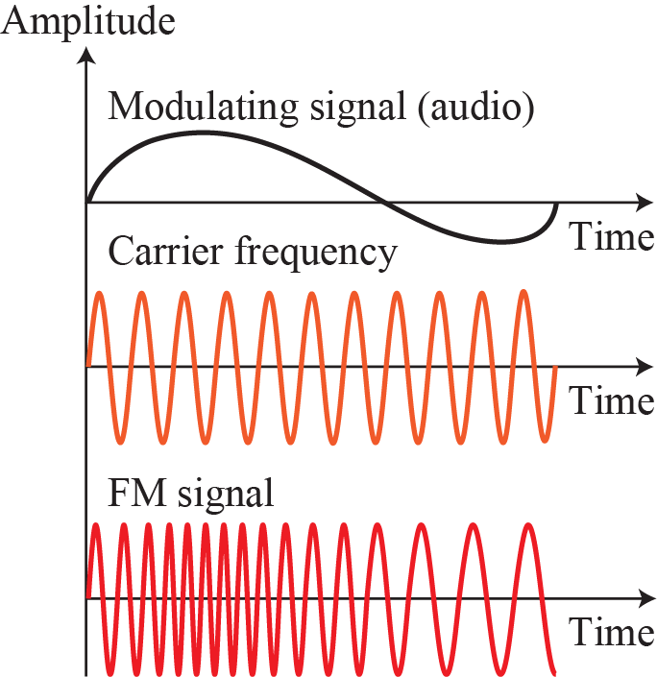
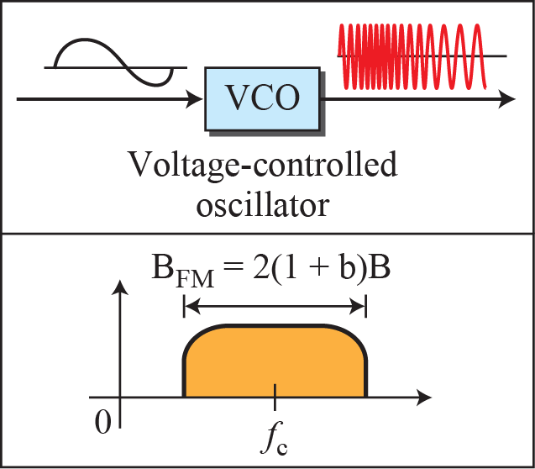
    5.2 Analog-to-Analog Conversion
    5.2.2 Frequency Modulation (FM)
the frequency of the carrier signal is modulated to follow the changing voltage level (amplitude) of the modulating signal
Fig. 5.18 FM

Slide 20
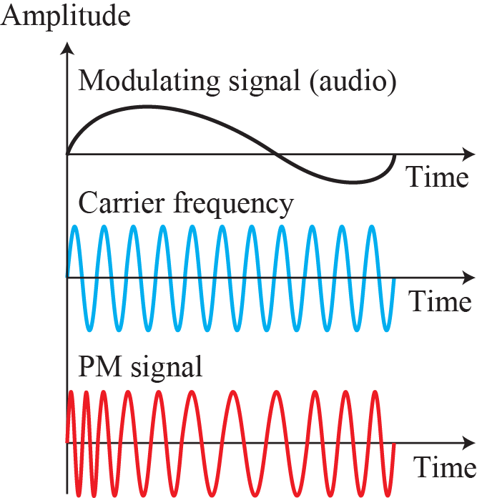
    5.2 Analog-to-Analog Conversion
    5.2.3 Phase Modulation (PM)
the phase of the carrier signal is modulated to follow the changing voltage level (amplitude) of the modulating signal.
Fig. 5.20 PM

Slide 21
    Homework
Homework
Read textbook pp. 155-181
Next Lecture
Chapter 6. Bandwidth Utilization:
Multiplexing and Spectrum Spreading

